Slide 1
Scenario 1 - Shakespeare
Alberta “Albi” Kovatcheva

Slide 2
Scenario
A linguist wants to compare the occurrence of nouns in two of his favorite Shakespeare plays, As You Like It and Julius Caesar. He counts them all, stores them in this dataset and wants to know if the number of nouns in the two plays differ from each other.

Slide 3
Hypothesis Testing
For this scenario, I conducted an independent t-test, because the linguist wants to compare the noun frequencies of two different plays.

Slide 4
Hypotheses
Null Hypothesis (H0): There is no notable difference in noun frequencies between the two plays from Shakespeare, ‘Julius Caesar’ and ‘As You Like It’.
Alternative Hypothesis (H1): There is a notable difference in noun frequencies between the two plays from Shakespeare, ‘Julius Caesar’ and ‘As You Like It’.

Slide 5
Requirements for t-tests
The t-test requires that the dependent variable is approximately normally distributed within each group.

Slide 6
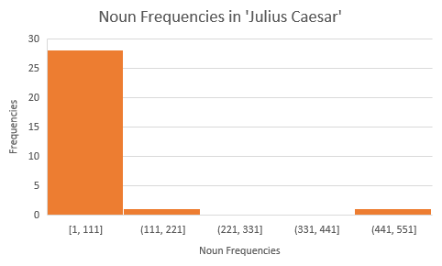
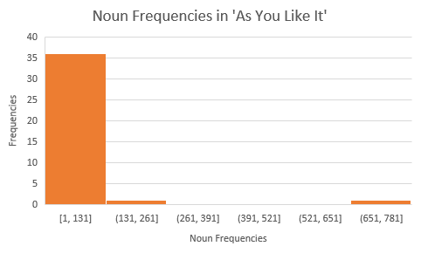
Verifying t-test Requirements
Neither dependent variable does not appear normally distributed. Therefore, the requirement for this t-test has not been met. However, I am proceeding with the testing for the purposes of this activity.

Slide 7
Descriptive Statistics
 | Results of t-Test
Test statistic (t) | -0.01778
P-value | 0.985542
 | 1- ‘Julius Caesar’ | 2- ‘As You Like It’
Mean Noun Frequency | 32.16667 | 32.65789
Standard Deviation | 100.6075 | 122.0322
Sample Size | 30 | 38
Degrees of Freedom | 29 | 37

Slide 8
Conclusions
Initially, it appears that ‘As You Like It’ possesses a greater noun frequency than ‘Julius Caesar’: mean 2 > mean 1.
However, p = 0.985542 & alpha = 0.05.
Therefore, p >> 0.05
Because p = 0.98552, the probability that both plays possess the same noun frequencies is approximately 98.6%.
I find sufficient evidence to ‘fail to reject’ the null hypothesis.
There is no notable difference in noun frequencies between both plays.
I am confident in the accuracy of this conclusion because both histograms look extremely similar.

